Slide 1


GRADE 8 ICT/DESIGN
Lesson 6: Random Numbers (Code.org 3b)
Ms. Abboud • Grade 8 - ICT/Design • Term 1, Week 11

Slide 2
Learning Objectives
WALT - We Are Learning To
WILF - What I'm Looking For
Use random numbers to create variation in a program.
My program uses randomNumber() correctly.
I can explain the range I chose.

Slide 3
Academic Vocabulary
Random Number
Range
A number the computer picks by chance from a range, so the result can change each time the program runs.
The smallest and largest numbers that randomNumber() can choose between.

Slide 4
Frayer Model: Random Number
DEFINITION
CHARACTERISTICS
A number the computer picks by chance from a range, so the result can change each time the program runs.
Picked by the computer; stays between a minimum and a maximum; set with randomNumber(min, max).
RANDOM NUMBER
EXAMPLES
NON-EXAMPLES
randomNumber(1, 6) is like rolling a die.
A fixed number like 5, which is the same every time the program runs.

Slide 5
National Identity Integration
UAE spirit of innovation: engineers test new systems many times before launch. Today you run a random program again and again to see how it behaves.

Slide 6
STARTER
Why Is It Different Each Time?
Watch the same program run three times.
Why is the picture different each time?
Hook • Engage & Ask
5 - 10 minutes

Slide 7
LESSON CORE
I Do: randomNumber(min, max)
randomNumber(min, max) picks a number by chance between a minimum and a maximum.
Test it with repeated runs, and store the result in a variable.
Gradual Release of Responsibility
35 - 45 minutes
Example: a random position
var x = randomNumber(50, 350);
ellipse(x, 200, 60, 60);
1 / 3

Slide 8
LESSON CORE
We Do: Run It Again and Again
Run the program several times and record how the output changes.
Update the value stored in a variable. What happens next run?
Gradual Release of Responsibility
35 - 45 minutes
2 / 3

Slide 9
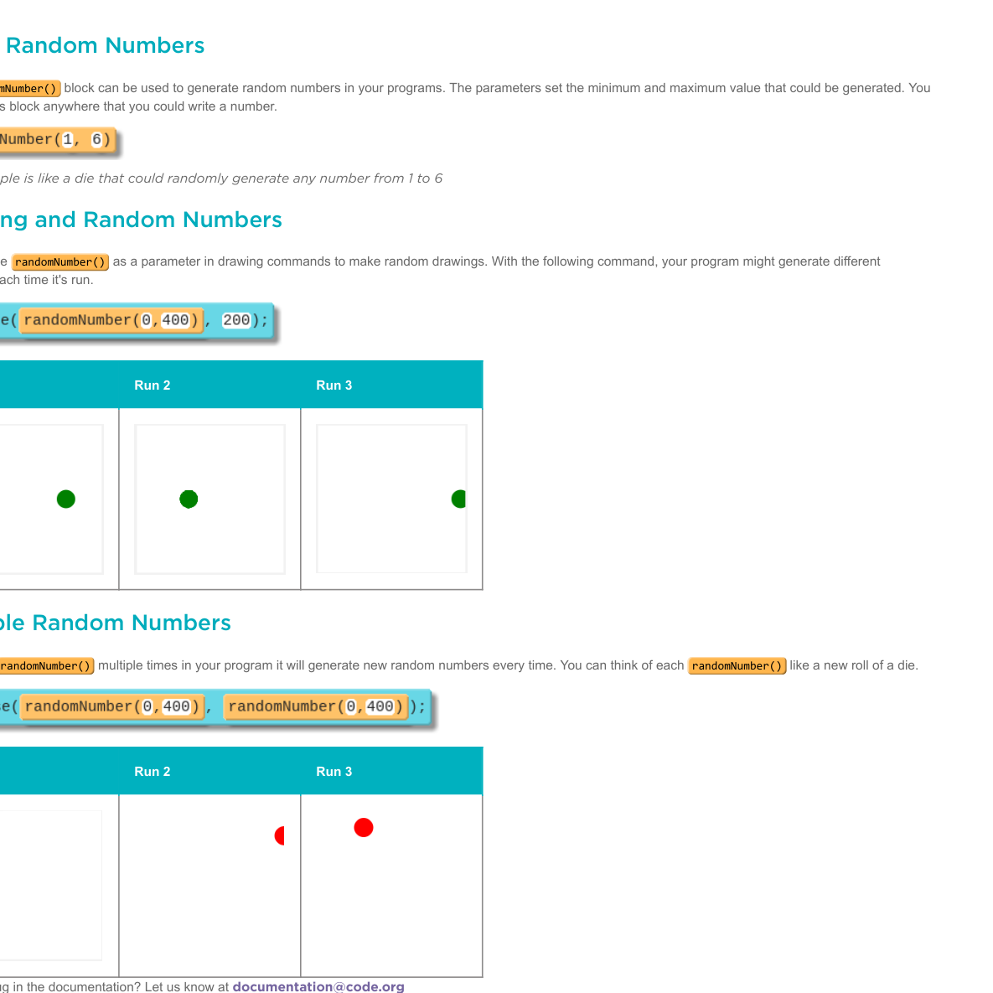
LESSON CORE
You Do: Randomize Your Picture
Complete the Game Lab levels.
Use randomNumber() with variables so your picture changes every run. Be ready to explain your range.
Code.org reference: Random Numbers
Gradual Release of Responsibility
35 - 45 minutes
3 / 3

Slide 10
CLOSURE
Teacher Check
Show your program running more than once.
Explain the range you chose and why.
Transition & Extend
5 - 10 minutes

